Slide 1

EP-297 Exploratory Project Report 2020-2021,Semester-4
Machine learning holography for 3D particle field imaging
Presented By:
Pushker Naresh,Engineering Physics, IDD, Part II,Roll No. 19174018
Supervised By:
Dr.Rakesh Kr. Singh
Department of Physics,
Indian Institute of Technology (BHU),
Varanasi - 221005

Slide 2
Contents
Objective
Deep Neural Networks
A quick review of Deep learning
Important terms related to project
Introduction
Methodology
Results
1.Assessment using synthetic holograms with constant particle concentration
2.Assessment using synthetic holograms with variable particle concentration
3.Assessment using experimental data
Summary and discussion
Future Goals
Code for 3D particle generated holography
Acknowledgements
References

Slide 3
Machine learning holography for 3D particle field imaging
Objective
As per the challenges arrising in particle holograms where accurate measurement of individual particles is crucial.
There were some methods that were developed earlier for the computational imaging tasks as for the significant improvement in the particle extraction rate, localization accuracy and speed compared to prior methods over a wide range of the particle concentrations, including highly dense concentrations but those methods were found to be unsuitable.
So in order to cope up those challenges discover a new learning based approach that can potentially improve our computational imaging tasks or it could be extended to the other types of computational imaging tasks with similar features. For the 3D particle field imaging using holography and demonstrate them with synthetic and experimental holograms.

Slide 4

AI vs ML vs DL

Slide 5
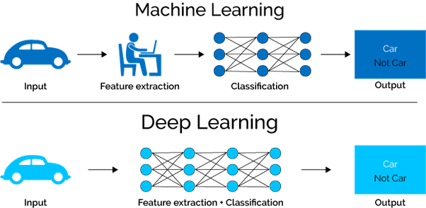
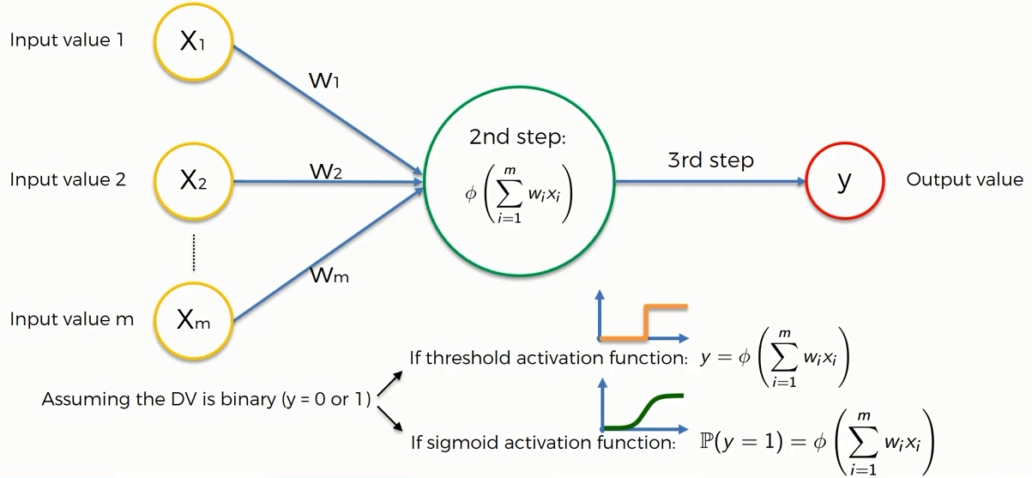
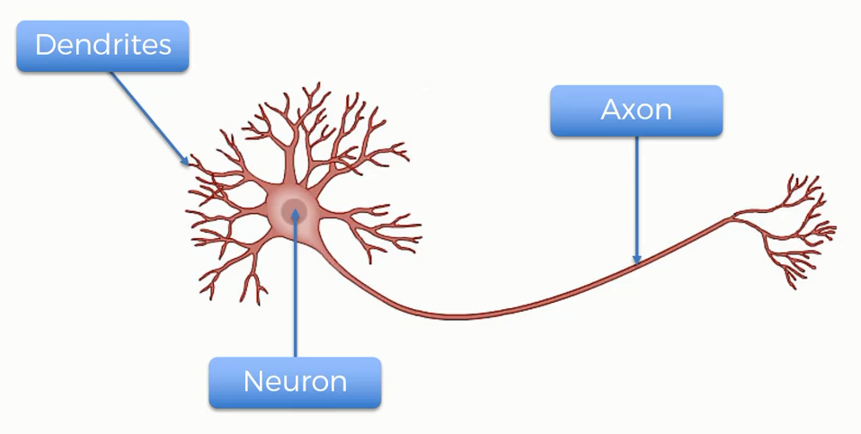
Deep learning is a machine learning technique that learns features and task directly from the data, where data may by images, text or sound!

Slide 6
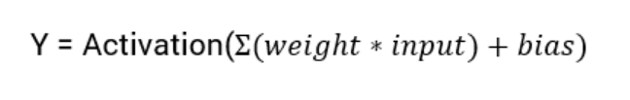
Activation Function
Activation functions are an extremely important feature of the artificial neural networks. They basically decide whether a neuron should be activated or not. Whether the information that the neuron is receiving is relevant for the given information or should it be ignored.

Slide 7
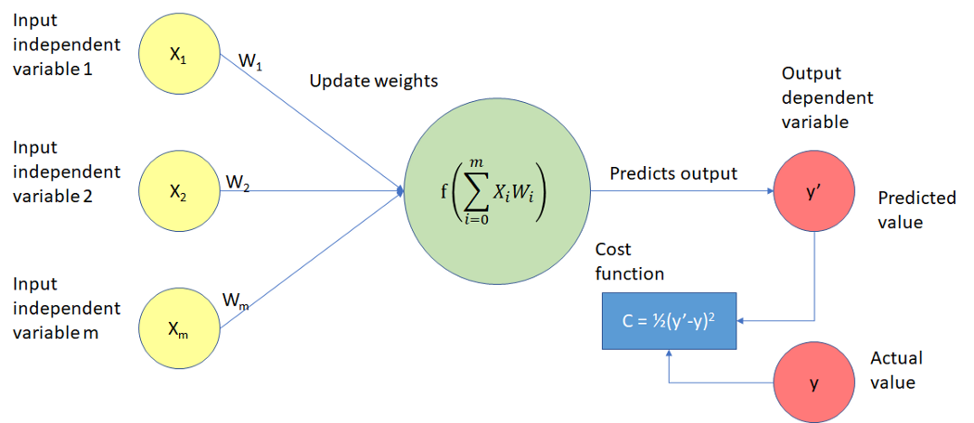
Loss/Cost function…
It is a function that measures the performance of a Machine Learning model for given data. Cost Function quantifies the error between predicted values and expected values and presents it in the form of a single real number. Depending on the problem Cost Function can be formed in many different ways.

Slide 8
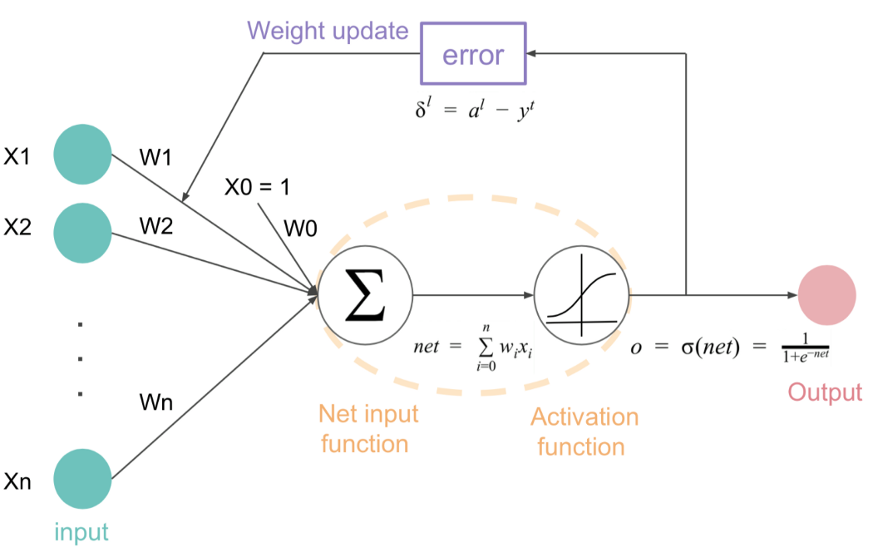
What is Optimizer !
Optimizers are algorithms or methods used to change the attributes of your neural network such as weights and learning rate in order to reduce the losses.
Optimization algorithms or strategies are responsible for reducing the losses and to provide the most accurate results possible

Slide 9
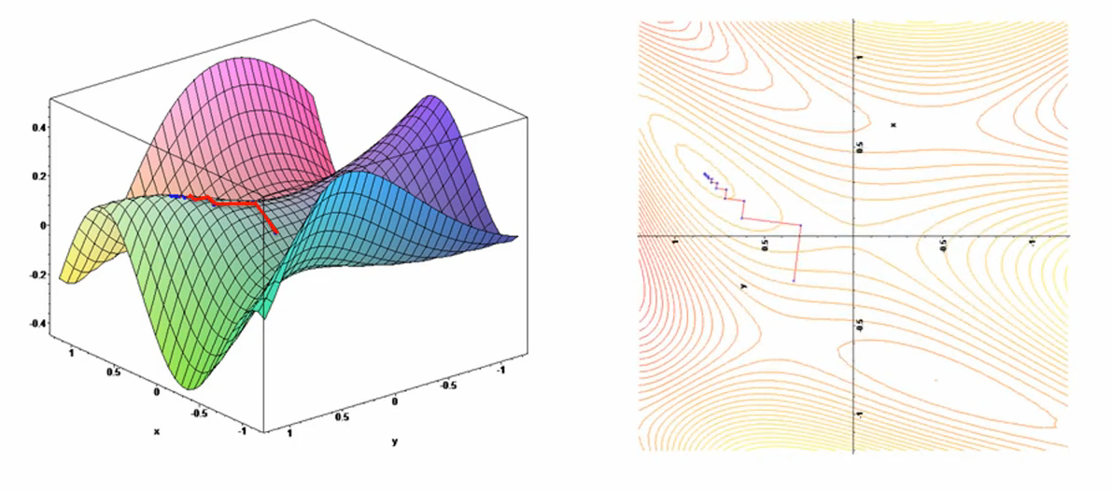
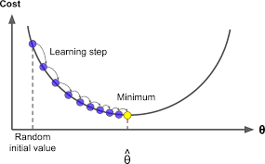
Role of an optimizer
Optimizers update the weight parameters to minimize the loss function. Loss function acts as guides to the terrain telling optimizer if it is moving in the right direction to reach the bottom of the valley, the global minimum.

Slide 10
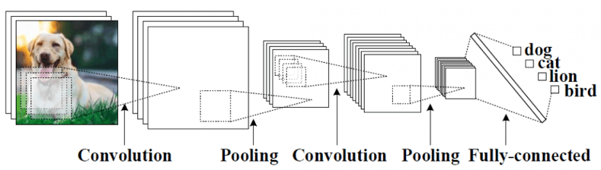
Convolutional Neural Network
Convolutional Neural Networks (CNN) is one of the variants of neural networks used heavily in the field of Computer Vision. It derives its name from the type of hidden layers it consists of. The hidden layers of a CNN typically consist of convolutional layers, pooling layers, fully connected layers, and normalization layers. Here it simply means that instead of using the normal activation functions defined above, convolution and pooling functions are used as activation functions.

Slide 11
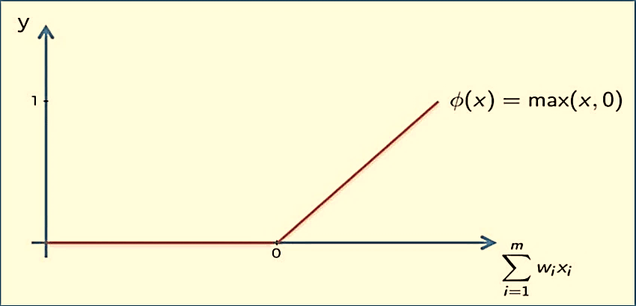
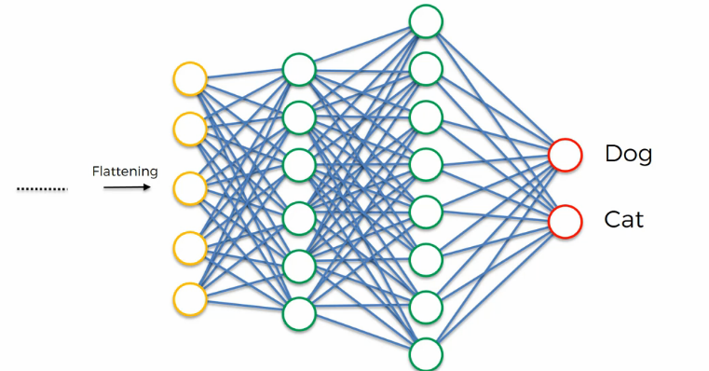
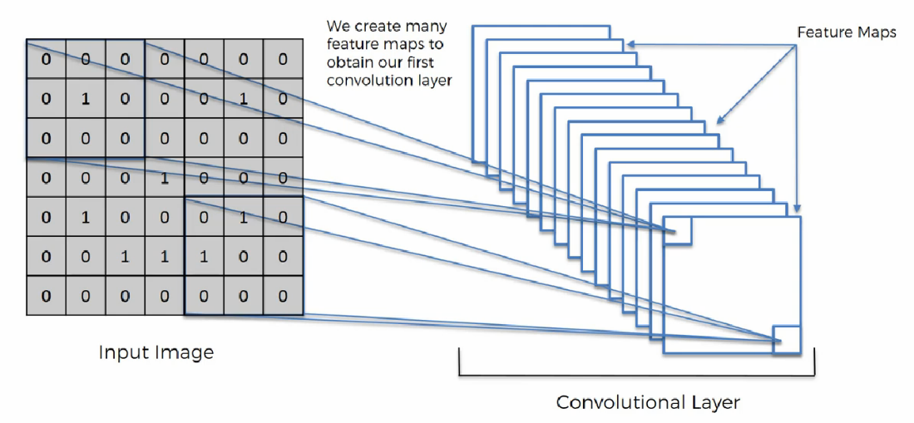
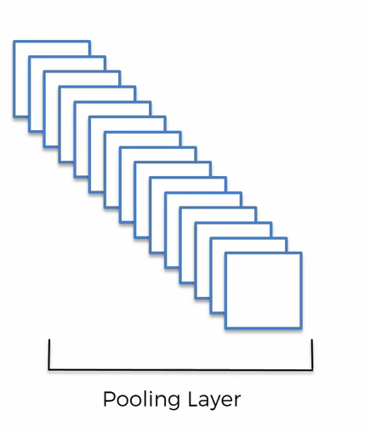
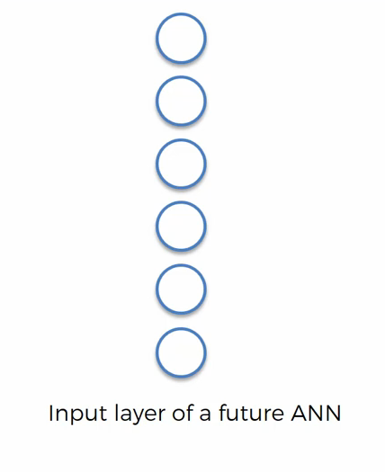
Convolutional Neural Network (CNN)
Image processing is a method to perform some operations on an image, in order to get an enhanced image or to extract some useful information from it. It is a type of signal processing in which input is an image and output may be image or characteristics/features associated with that image.
Computer vision is a field of computer science that works on enabling computers to see, identify and process images in the same way that human vision does, and then provide appropriate output. It is like imparting human intelligence and instincts to a computer. In reality though, it is a difficult task to enable computers to recognize images of different objects.

Slide 12
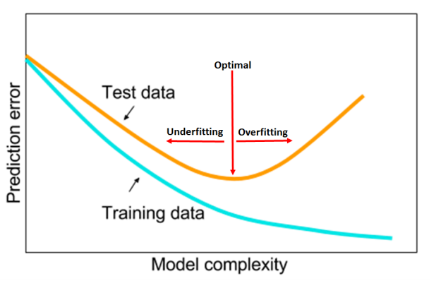
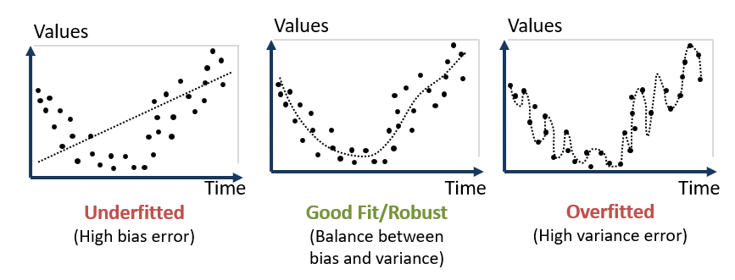
Underfitting and Overfitting :
Overfitting :
A model is said to be overfit if it is over trained on the data such that, it even learns the noise from it. An overfit model learns each and every example so perfectly that it misclassifies an unseen/new example. For a model that’s overfit, we have a perfect/close to perfect training set score while a poor test/validation score.
Underfitting :
A model is said to be underfit if it is unable to learn the patterns in the data properly. An underfit model doesn’t fully learn each and every example in the dataset. In such cases, we see a low score on both the training set and test/validation set.

Slide 13
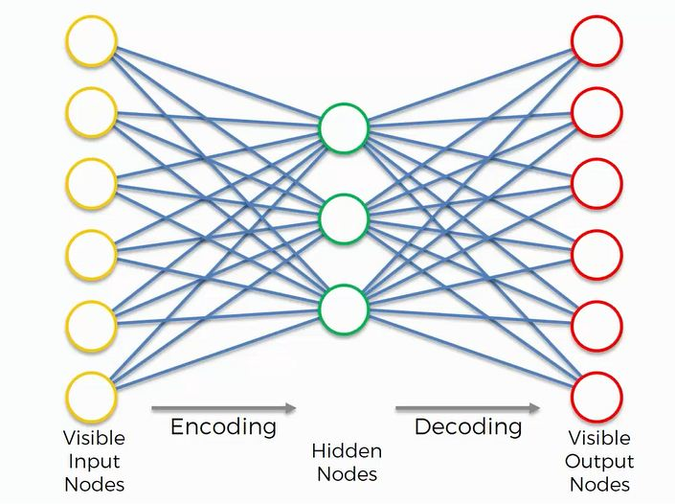
Autoencoder
An autoencoder is a type of artificial neural network used to learn efficient data codings in an unsupervised manner. The aim of an autoencoder is to learn a representation (encoding) for a set of data, typically we can say an Autoencoder, by design, reduces the data dimensions by learning how to ignore the noise in the data.

Slide 14
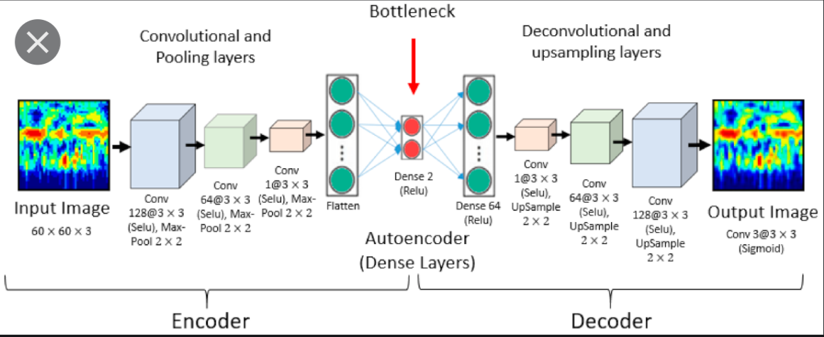

Autoencoder
Autoencoder Components:
Autoencoders consists of 4 main parts:
1- Encoder: In which the model learns how to reduce the input dimensions and compress the input data into an encoded representation.
2- Bottleneck: which is the layer that contains the compressed representation of the input data. This is the lowest possible dimensions of the input data.
3- Decoder: In which the model learns how to reconstruct the data from the encoded representation to be as close to the original input as possible.
4- Reconstruction Loss: This is the method that measures measure how well the decoder is performing and how close the output is to the original input.

Slide 15
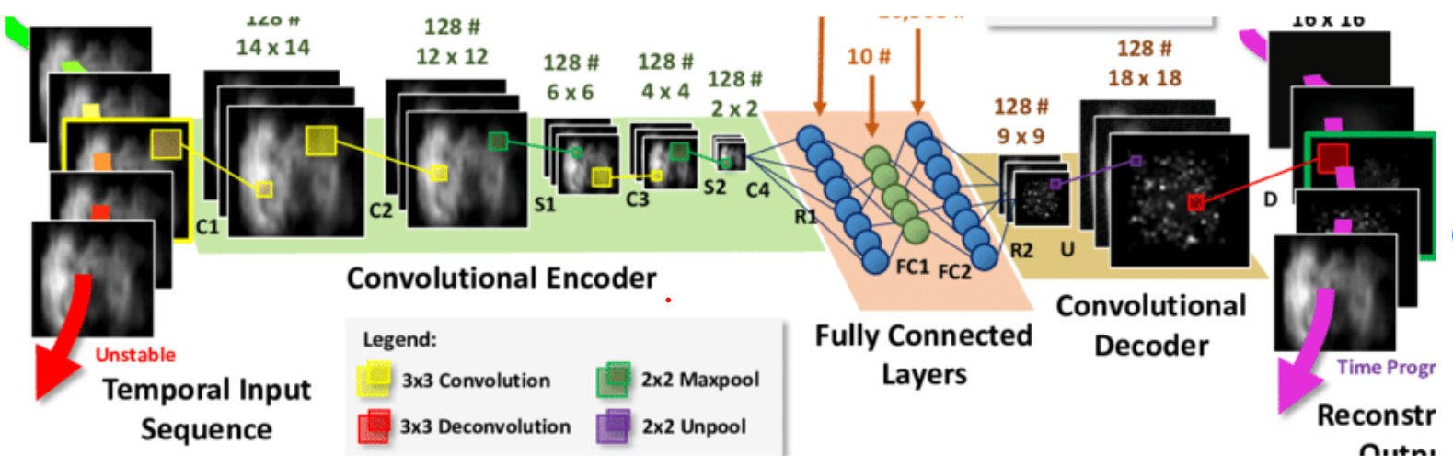
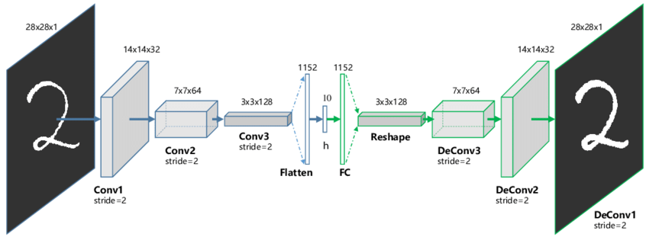
Convolutional Autoencoder
Autoencoders in their traditional formulation does not take into account the fact that a signal can be seen as a sum of other signals.
Convolutional Autoencoders use the convolution operator to exploit this observation.
They learn to encode the input in a set of simple signals and then try to reconstruct the input from them, modify the geometry or the reflectance of the image.
4. They are the state-of-art tools for unsupervised learning of convolutional filters.
5. Once these filters have been learned, they can be applied to any input in order to extract features.
6. These features, then, can be used to do any task that requires a compact representation of the input, like classification.

Slide 16
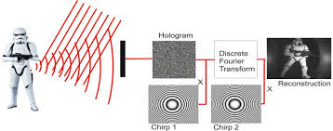
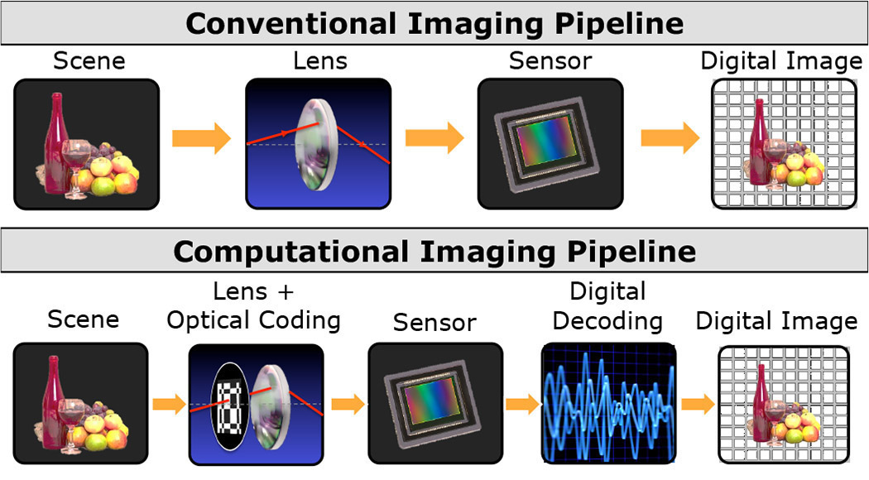
Digital Holography:
Digital holography refers to the acquisition and processing of holograms with a digital sensor array ,typically a CCD camera or a similar device. Digital holography offers a means of measuring optical phase data and typically delivers three-dimensional surface or optical thickness images. Several recording and processing schemes have been developed to assess optical wave characteristics such as amplitude, phase, and polarization state, which make digital holography a very powerful method for metrology applications .
Computational Imaging:
Computational imaging is the process of indirectly forming images from measurements using algorithms that rely on a significant amount of computing.

Slide 17
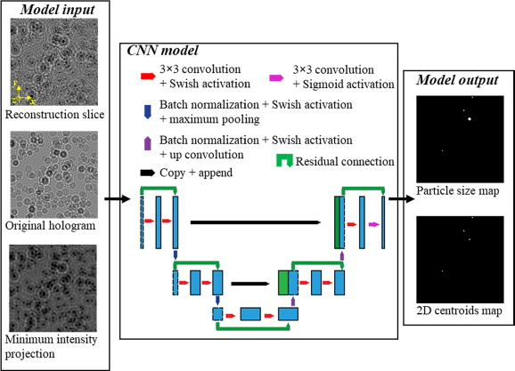
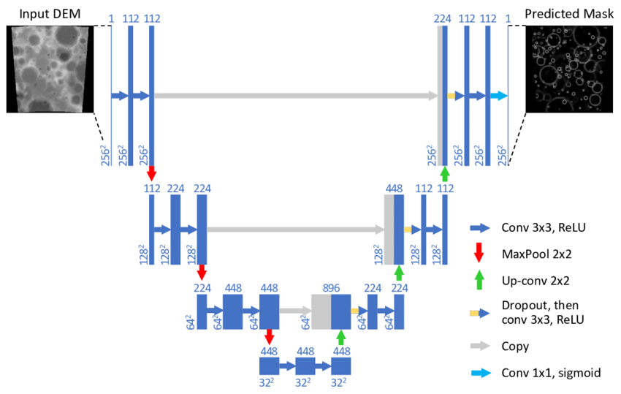
U-Net Model:
The architecture looks like a ‘U’ which justifies its name. This architecture consists of three sections: The contraction, The bottleneck, and the expansion section.Also after each block number of feature maps used by convolutional layer get half to maintain symmetry. However, every time the input is also get appended by feature maps of the corresponding contraction layer. This action would ensure that the features that are learned while contracting the image will be used to reconstruct it. The number of expansion blocks is as same as the number of contraction block. After that, the resultant mapping passes through another 3X3 CNN layer with the number of feature maps equal to the number of segments desired.
Skip connection:
It is a widely-used technique to improve the performance and the convergence of deep neural networks, which is believed to relieve the difficulty in optimization due to non-linearity by propagating a linear component through the neural network layers.

Slide 18
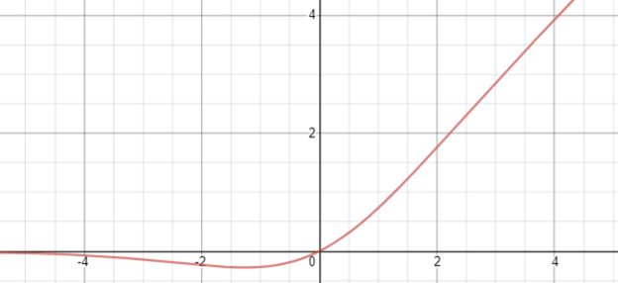
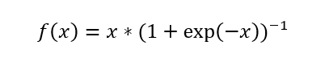
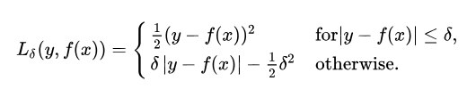
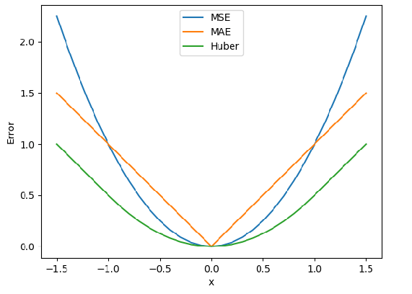
Swish Activation :
It is a smooth, non-monotonic function that consistently matches our performance on deep networks applied to a variety of challenging domains such as Image classification and Machine translation. It is unbounded above and bounded below & it is the non-monotonic attribute that actually creates the difference. It has been inspired by the use of Sigmoid function
HuberLoss:
Huber Loss = Combination of both MSE and MAE
Huber loss is both MSE and MAE means it is quadratic(MSE) when the error is small else MAE.

Slide 19
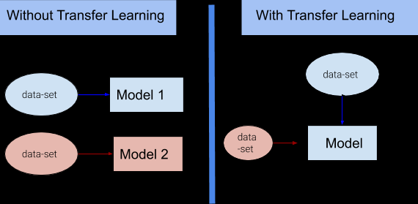
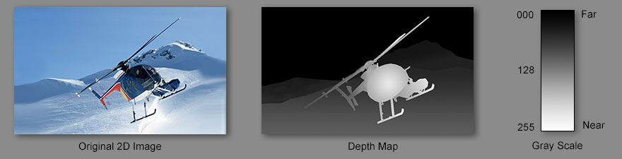
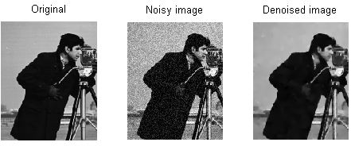
Transfer learning is a machine learning method where a model developed for a task is reused as the starting point for a model on a second task.
It is a popular approach in deep learning where pre-trained models are used as the starting point on computer vision and natural language processing tasks .transfer learning used to speed up training and improve the performance of your deep learning model.
Depth map:
In 3D computer graphics and computer vision, a depth map is an image or image channel that contains information relating to the distance of the surfaces of scene objects from a viewpoint. The term is related to and may be analogous to depth buffer, Z-buffer, Z-buffering and Z-depth.
Total Variation (TV) regularization has evolved from an image denoising method for images corrupted with Gaussian noise into a more general technique for inverse problems such as deblurring, blind deconvolution, and inpainting, which also encompasses the Impulse, Poisson, Speckle, and mixed noise models

Slide 20
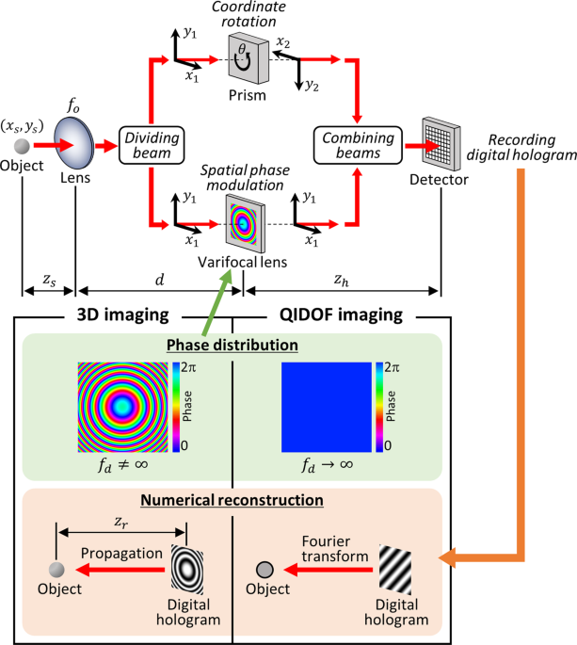
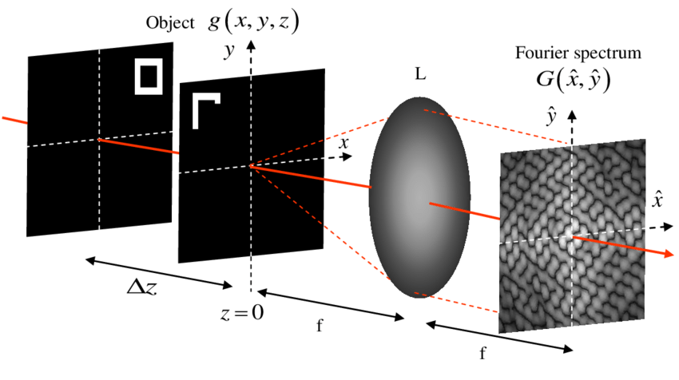
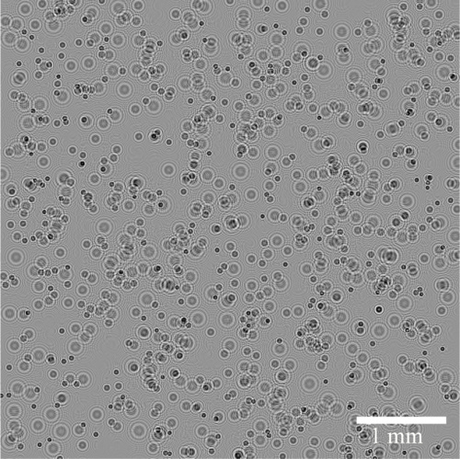
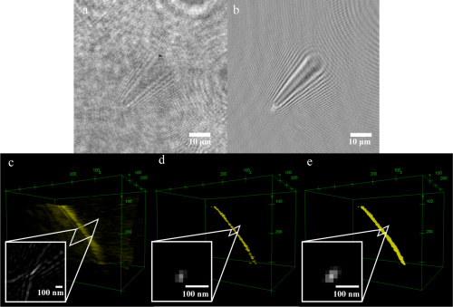
The angular spectrum method is a technique for modeling the propagation of a wave field. This technique involves expanding a complex wave field into a summation of infinite number of plane waves. Its mathematical origins lie in the field of Fourier optics
Holgram Datasets:
Sample of simulated hologram containing 1000 particles

Slide 21
Introduction
In the past few decades, three-dimensional (3D) imaging has grown in popularity for measurements of particle size, shape, position, and motion in fields such as fluid dynamics, environmental science etc.
Digital holography (DH) has recently emerged as a powerful tool for such imaging tasks and is particularly useful for many in situ applications owing to its simple and compact setup. DH encodes complex information from the particles (e.g., 3D position and size) onto a 2D image called a hologram by recording the interference between a reference light wave and light scattered from the particles.The information can subsequently be recovered from the hologram through a digital reconstruction process.
Many approaches to overcome these issues focus on hardware design to improve the hologram quality or encode more information during the recording step of holography. However, the implementation of these approaches requires sophisticated mechanical and optical components.

Slide 22
Recently, machine learning using deep neural networks (DNNs) has emerged as a prevailing tool for various image analysis tasks. Adoption of DNNs has drastically enhanced processing speed and yielded more accurate results than conventional inverse approaches for some applications.Machine learning in DH has been adopted for transforming hologram reconstructions to microscopic images similar to those commonly used in biological and medical examination, and classification of the particle species captured in the hologram.
On comparison with other method, we have identified three unique challenges associated with 3D particle imaging using DH.
1.First,unstabilty in the training process:While the signal of an individual object can spread over a large region of the hologram the reconstructed particle field usually consists of a group of sparse objects. When a learning-based approach is used to replace the reconstruction, this sparsity causes the training process to be highly unstable and produce incorrect results.
2.Second,requirement for more accuracy:3D particle field reconstruction requires very accurate measurements for each particle which differs from many conventional learning-based imaging tasks such as classification or global regression of the image .

Slide 23
3.Finally,limited generalisability of model: the desired metrics, recording parameters, and hologram appearance are coupled, limiting the generalizability of a model trained on a specific set of data.
To address the above-mentioned issues, we present in this paper a specially-designed machine learning approach for 3D particle field reconstruction in DH, which can also be employed in other computational imaging tasks sharing similar traits.
Our approach uses a U-net architecture incorporating residual connections, Swish activation, hologram preprocessing, and transfer learning to cope with challenges arising in particle holograms where accurate measurement of individual particles is crucial.

Slide 24
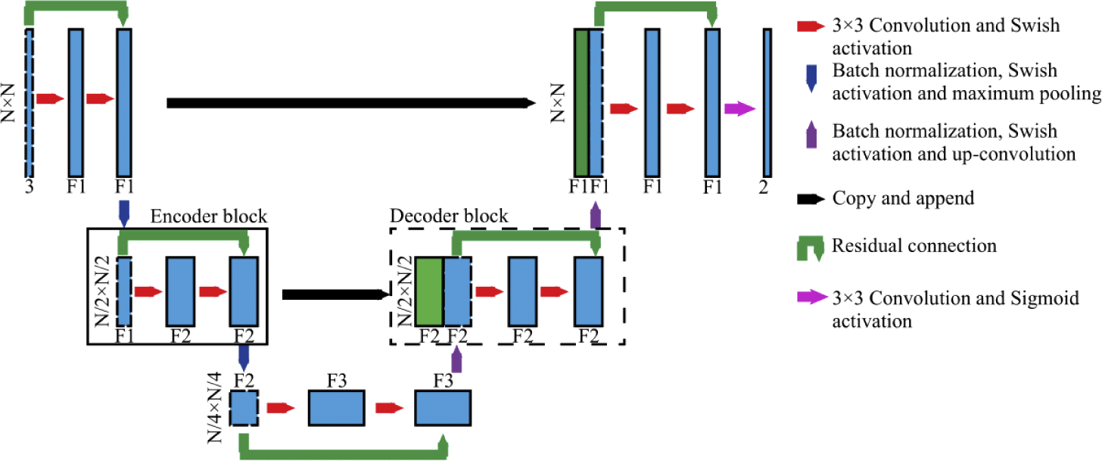
Methodolgy
Our machine learning approach for particle field reconstruction from a hologram uses a specially designed U-net architecture, which takes the holograms as input and computes the 3D location of particles as output.U-net is a type of CNN developed for image segmentation that has also been used in learning-based image-to-image transformations and multi-object classification from single images.
Model part:
U-net consists of a series of encoder and decoder blocks, corresponding to solid and dashed black boxes.In the encoder block, two consecutive sets of convolution layers and activation functions are used to encode local features of input images into channels. Two encoder blocks are connected by a maximum pooling layer which downsamples the feature maps in order to extract global features. The decoder block is similar but in reverse. Two consecutive convolution layers are used to decode the channels to form an image and two decoder blocks are connected by up-convolution layers to resize feature maps.
Fig. 1. The specially-designed U-net architecture for holographic reconstruction of 3D particle field

Slide 25
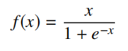
U-net includes skip connections which combines the local and global features of images for training in the deeper stage of the network. U-net is more suitable for particle field reconstruction from a hologram because the skip connections make use of the spread of individual particle information over the a large portion of the image.
In our U-net architecture, we use a U-net with 4 encoders and 3 decoders, and the number of output encoder channels are 64 and 512 for the first and last encoder, respectively.
U-net has a residual connection within each encoder and decoder block and uses a Swish (Sigmoid-weighed Linear Unit) activation function for all except the last layer. The residual connection increases the training speed and reduces the chance of training to trapped at a local minimum.Swish activation function in the final decoder block to produce results within the range from 0 to 1.
Input part:
Thirteen datasets, with particle concentration between 1.9×10−4 and 6.1×10−2 ppp, are generated to train and test the models.The training input consists of three channels: an original hologram, the corresponding images of pixel depth projection (i.e., depth map) and maximum phase projection. The particles within the holograms are randomly distributed with a distance between 1 mm and 2.28 mm to the sensor.

Slide 26
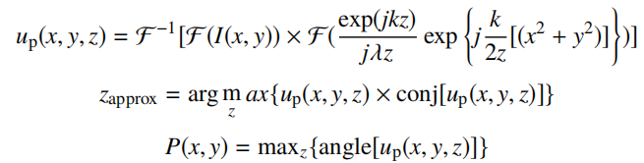
On preprocessing the holograms we get depth map and phase projections as additional information which helps to incorporate existing hologram formation knowledge to the model and reduces the model to fully learn the required physics during training. A noticeable improvement was observed with these preprocessing steps in comparison to training directly on the raw holograms.
Using the angular spectrum method, a 3D complex optical field, up (x, y, z), is generated from the original hologram I(x,y). The depth map is generated by projecting the z locations where the pixels have the maximum intensity from up (x, y, z) to xy plane, and the maximum phase projection is calculated using eqns.
Training Part
The U-net architecture is implemented using Keras with the TensorFlow backend. The training is conducted on a Nvidia RTX 2080Ti GPU. The Adam optimizer is used with the default learning rate of 0.001. We have a base model is first trained on 2500 holograms for 480 epochs (in total 13.5 hours). For each subsequent particle concentration, a dataset of 2000 holograms is trained for upto (2.7 hours for each case). This transfer learning approach substantially decreases the training requirement (i.e., dataset size and training time) for new hologram datasets.

Slide 27
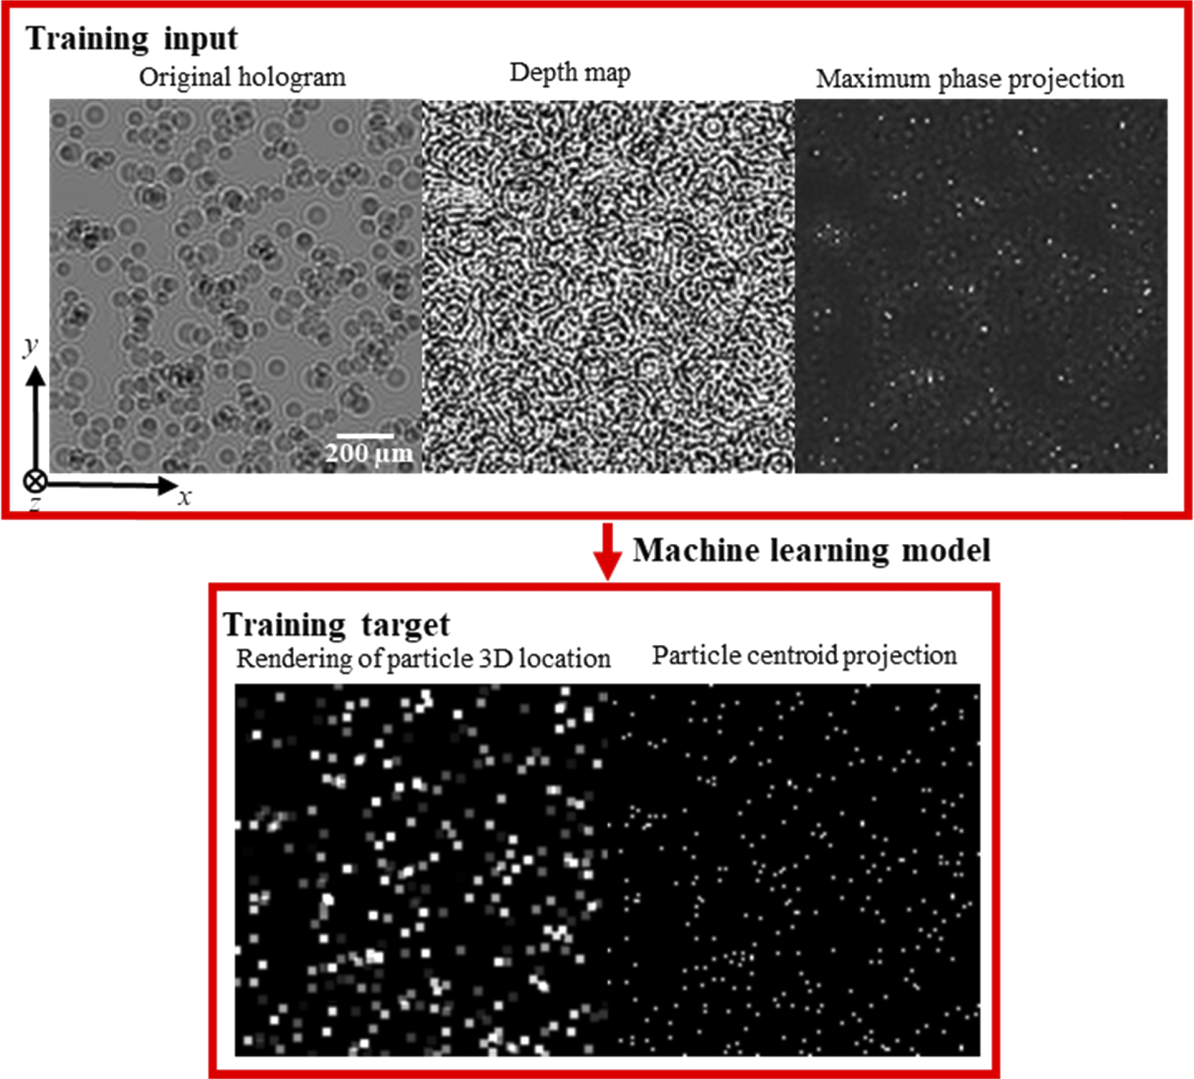
Output Part:
The training target consists of two output channels. The first is a grayscale channel in which the pixel intensity corresponds to the relative depth of each particle determined by using (Huber loss)MAE as loss function improves the training robustness and prediction accuracy and the second is a binary image of the particle xy centroids by using MSE loss function regularized by the total variation (TV) of the prediction.
To extract the particles from the model output, the predicted particle xy centroid map is first binarized with a threshold of 0.5 to extract the xy centroids of the particles.Subsequently, from the depth-encoded grayscale output, we use the intensity value of the corresponding pixels in the depth map as the particle depth.

Slide 28
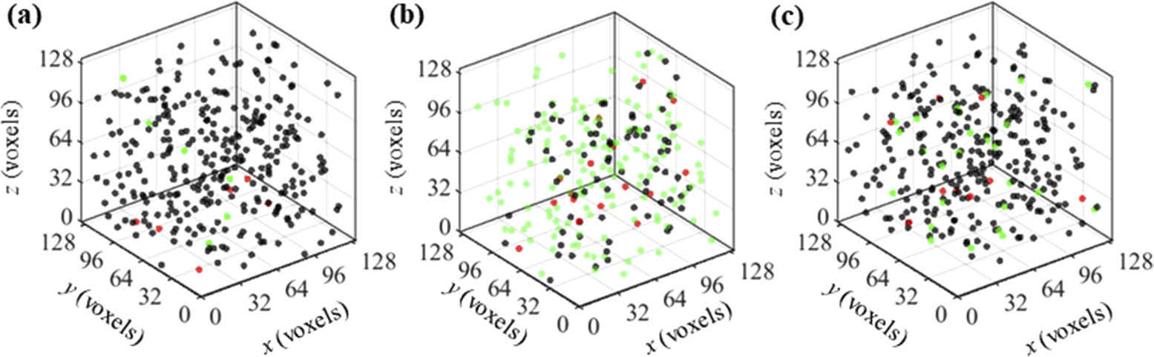
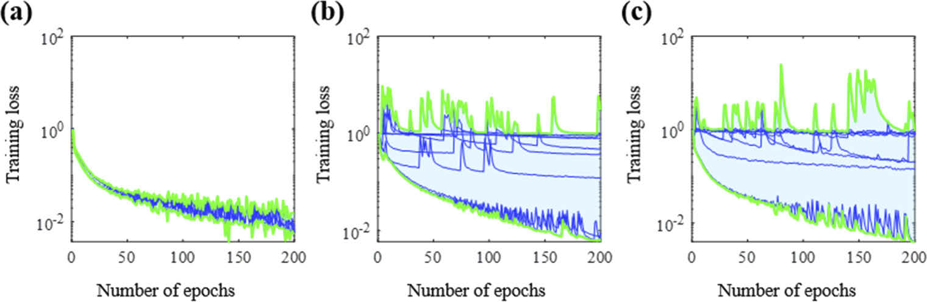
Results
1. Assessment using synthetic holograms with constant particle concentration
To analyze the impacts of the unique features in our U-net architecture on the training process, we compare the training loss decay for the first 200 epochs of different model variants on the 1.8×10−2 ppp dataset.
The result is that the model does not converge to an optimal solution and produces very inaccurate pixel intensity predictions or white noise outputs for the worst scenarios.As a result, the training is likely to reach a plateau in the first few epochs and the resulting models generate 2D white noise images.

Slide 29
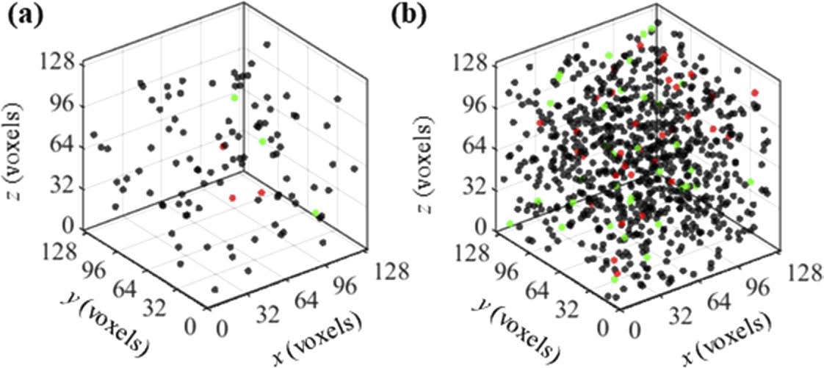
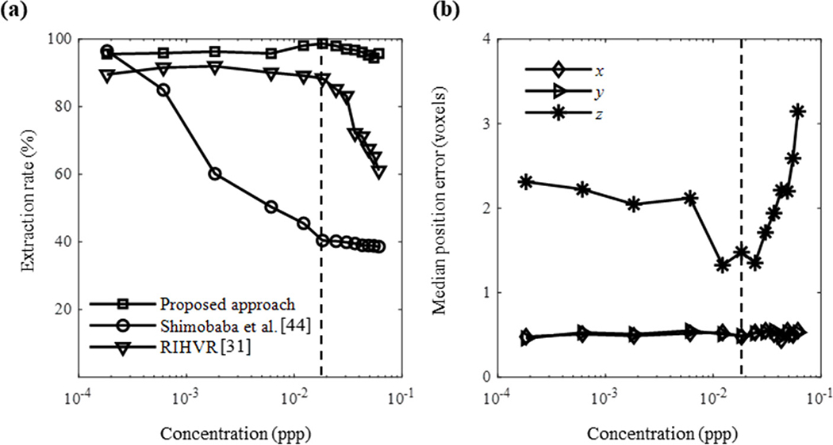
2. Assessment using synthetic holograms with variable particle concentration
The particle extraction rate and positioning accuracy using the proposed transfer learning approach are assessed for variable particle concentrations from 1.9×10−4 ppp to 6.1×10−2 ppp.From an assessment of 100 holograms for each particle concentration,
Our machine learning approach shows no such drop within the studied range as our pre-processing and transfer learning approaches significantly reduce the training requirements to yield a high extraction rate and positioning accuracy for new holograms especially for high concentration cases that potentially enables improved spatial resolution tracer-based flow diagnostic techniques such as particle image velocimetry (PIV) and particle tracking velocimetry (PTV).

Slide 30
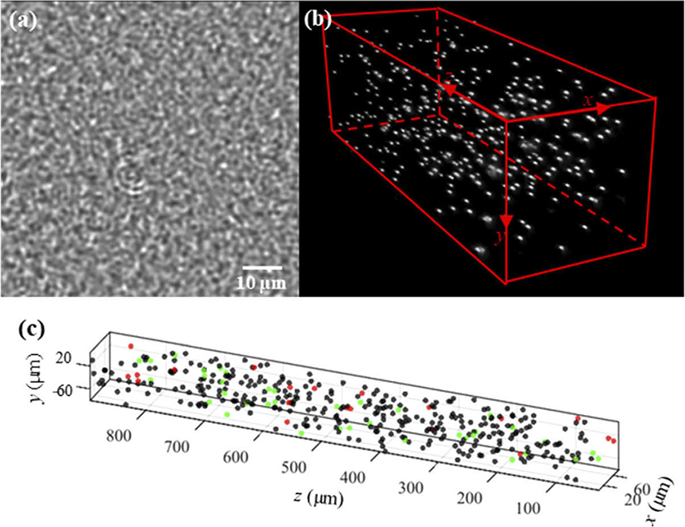
3. Assessment using experimental data
The training dataset consists of 7500 randomly cropped 128×128 pixel tiles from the enhanced hologram and their corresponding particle locations from the 3D fluorescence scan volume.We use the same method as the synthetic case to pair the predicted particles to the ground truth. As despite of the noisy input, the predicted results from the trained model match well to the ground truth.
The test of 100 randomly cropped 128×128 pixel tiles from a validation hologram imaging a different region of this sample yields a 90% extraction rate with a positioning error less than 1 voxel (0.65 µm) in the x and y directions and 5.24 voxels (13.1 µm) in the z direction.

Slide 31
Summary and discussion
In the present paper, we introduce a new learning-based approach for 3D particle field reconstruction from holograms. For holograms, the information in the training input (i.e. the diffraction fringes of an individual particle) can significantly spread beyond the in-focus location of the particle, while the training target consists of a sparse particle field where accurate measurement of each particle is crucial. To handle these traits, our specially-designed U-net architecture has three input channels (original holograms, depth, and maximum phase projection maps) and two output channels (depth and centroid maps of reconstructed particles).
Compared to simple feed-forward networks, U-net combines both local and global features which is particularly suitable for particle hologram reconstruction where the reconstructed particle target is small, but its information can spread significantly beyond its in-focus position in the hologram. The 2D depth and maximum phase projection map channels use the angular spectrum method from conventional holographic reconstruction to incorporate hologram formation knowledge into the U-net training and reduce the need to fully learn the required physics.
In addition, our architecture employs residual connections and the Swish activation function to reduce the likelihood of the training becoming trapped in local minima or producing a large number of dead neurons.

Slide 32
We use two types of loss functions – Huber loss(MAE) and TV-regularized MSE loss – for the output channels of particle depth and particle centroids, respectively, in order to improve the prediction accuracy, produce a smooth background, and reduce ghost particles.
Lastly, a transfer learning approach is adopted to reduce the training requirements for new hologram datasets. Through an assessment of synthetic holograms, our approach is suitable for processing much denser particle concentrations than prior approaches, with a 94% extraction rate at a concentration (6.1×10−2 ppp) 305 times higher than previously demonstrated with a machine learning approach and 4 times higher than the 90% extraction limit for a state-of-the-art analytical method. This improvement to the maximum concentration comes while also achieving improved positioning accuracy (error of <3.2 voxels). Validating the proposed method on experimental holograms with a concentration of 0.020 ppp results in an extraction rate over 90% with a positioning error of 5.24 voxels (13.1 µm) for the depth measurement.
These assessments demonstrate the unique power of machine learning for particle hologram reconstruction with a broad range of particle concentrations. Finally, our learning-based hologram reconstruction is more than 30 times faster than the analytical other previous method, even though minimal effort has been undertaken to optimize the speed of the current approach.

Slide 33
Future Goals
We suggest that the proposed method can be generalized for other sparse field imaging tasks such as imaging individual brain neuron activities, particle localization with synthetic aperture or defocusing imaging, and imaging through diffusive media.While our machine learning approach has equal or superior performance compared to state-of-the-art conventional hologram reconstruction methods, there remains room for improvement.
On going work aims to synthesize holograms with sufficient fidelity to train a model suitable for processing experimental images. Such an approach can substantially reduce the cost of collecting ground truth measurements and has been proven effective for image classification tasks and 2D shadow image particle segmentation . Additionally, although our learning-based approach has achieved significant speed improvement in comparison to conventional reconstruction methods, more than 90% of our total processing time is consumed in pre- and post-processing steps.

Slide 34

Code for 3D computer generated holography using deep learning
#importing libraries
import tensorflow as tf
import os
import numpy as np
import matplotlib.pyplot as plt
from time import time
!git clone https://github.com/Pushker-stark/DeepCGH.git
os.chdir('DeepCGH')
from deepcgh import DeepCGH_Datasets, DeepCGH
from utils import GS3D, display_results, get_propagate
retrain = True
coordinates = False
data = {'path' : 'DeepCGH_Datasets/Disks',# path to store the data
'shape' : (512, 512, 3),# shape of the holograms. The last dimension determines the number of depth planes
'object_type' : 'Disk',# shape of the object in simulated images, can be disk, square, or line
'object_size' : 10,# has no effect if object type is 'Line'
'object_count' : [27, 48],# number of random objects to be created
'intensity' : [0.2, 1],# the (range of) intensity of each object. If a range is specified, for each object the intensity is randomly determined
'normalize' : True,# if the data is 3D, it'll normalize the intensities from plane to plane (see manuscript fot more info)
'centralized' : False,# avoids putting objects near the edges of the hologram (useful for practical optogenetics applications)
'N' : 100, # number of sample holograms to generate
'train_ratio' : 90/100,# the ratio of N that will be used for training
'compression' : 'GZIP',# tfrecords compression format
'name' : 'target',# name of the dictionary that contains the targets (leave as "target" if you're not changing the structure of network input)
}

Slide 35
dset = DeepCGH_Datasets(data)
dset.getDataset()
model = {'path' : 'DeepCGH_Models/Disks',# the path to the saved model
'plane_distance':0.005,# the physical distance between depth planes when we're doing 3D holography
# physical setup parameters
'wavelength':1e-6,# the wavelength of the laser (both simulations and experiments)
'pixel_size':0.000015,# size of the SLM pixel sizes
'int_factor':16,# the interleaving factor
# CNN model and training parameters
'n_kernels':[ 64, 128, 256],# the number of kernels in the U-Net model (see the manuscript)
'input_name':'target',# name of the input layer in the U-Net model
'output_name':'phi_slm',# name of the output layer
'lr' : 1e-7,# learning rate of the optimizer
'batch_size' : 8,
'epochs' : 1,
'shuffle' : 8,# determine how many samples are going to be shuffled
'token' : '64',# string to be attached to the name of the model to differentiate it from similar models
'max_steps' : 5000 # maxmimum number of batches/steps to be processed
}
dcgh = DeepCGH(data, model)
dcgh.train(dset)
image = dset.get_randSample()[np.newaxis,...]
# making inference is as simple as calling the get_hologram method
phase = dcgh.get_hologram(np.zeros_like(image)) # the very first inference takes a long time (a known tensorflow characteristic)

Slide 36
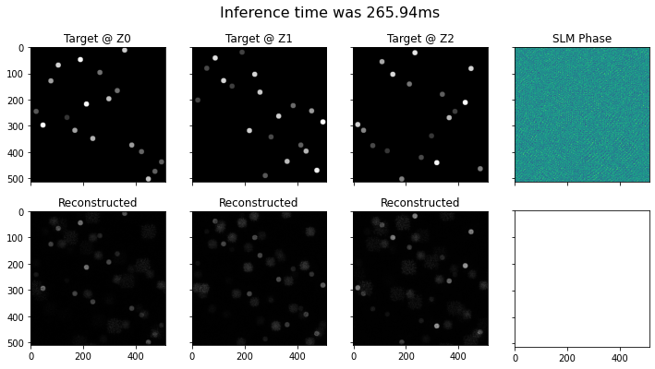
t0 = time()
phase = dcgh.get_hologram(image)
t = time() - t0
#Now we simulate the hologram that this phase will generate:
propagate = get_propagate(data, model)
reconstruction = propagate(phase)
display_results(image, phase, reconstruction, t)

Slide 37
Acknowledgements
I here would like to thank Prof.Rakesh Kr. Singh Sir for providing me such a task to explore the further areas related to optics .
Also to learn such a advanced technologies like Deep learning,Computer Vision and its applications on a field related to optics.And to guide me to research on them by supervising us on our Exploratory Project.
References
Research Paper on Machine learning holography for 3D particle field imaging by Siyao Shao,Kevin Mallery,Santosh Kumar,And Jiarong Hong.
Machine learning and Deep learning by Andrew Ng on coursera.
Recognizance machine learning event workshops done by IIT (BHU) Varanasi Electrical Dept.
Udyam’21 workshops and events of Mossaic & Cassandra which is based on computer vision(CNN) and Data Science,conducted by IIT (BHU) Varanasi Electronics Dept.
Fahad Hussain Deep learning Youtube playlist.
Thankyou

